Slide 1
The Influence of Media on Public Perception of AI
Chris Kong, Cyndi Liu, Alex Zhang
2024-03-10

Slide 2
CONTENTS
Introduction
Methodology - Analyzing Media Narratives
Unveiling Media Narratives
Technical Insights from Data Analysis
Societal Implications and Recommendations
Conclusion and Future Directions
Q&A Session

Slide 3
Introduction
01
Context: AI is rapidly transforming our world, drawing mixed reactions influenced by media representation. This section examines how media narratives sway public attitudes toward AI.

Slide 4
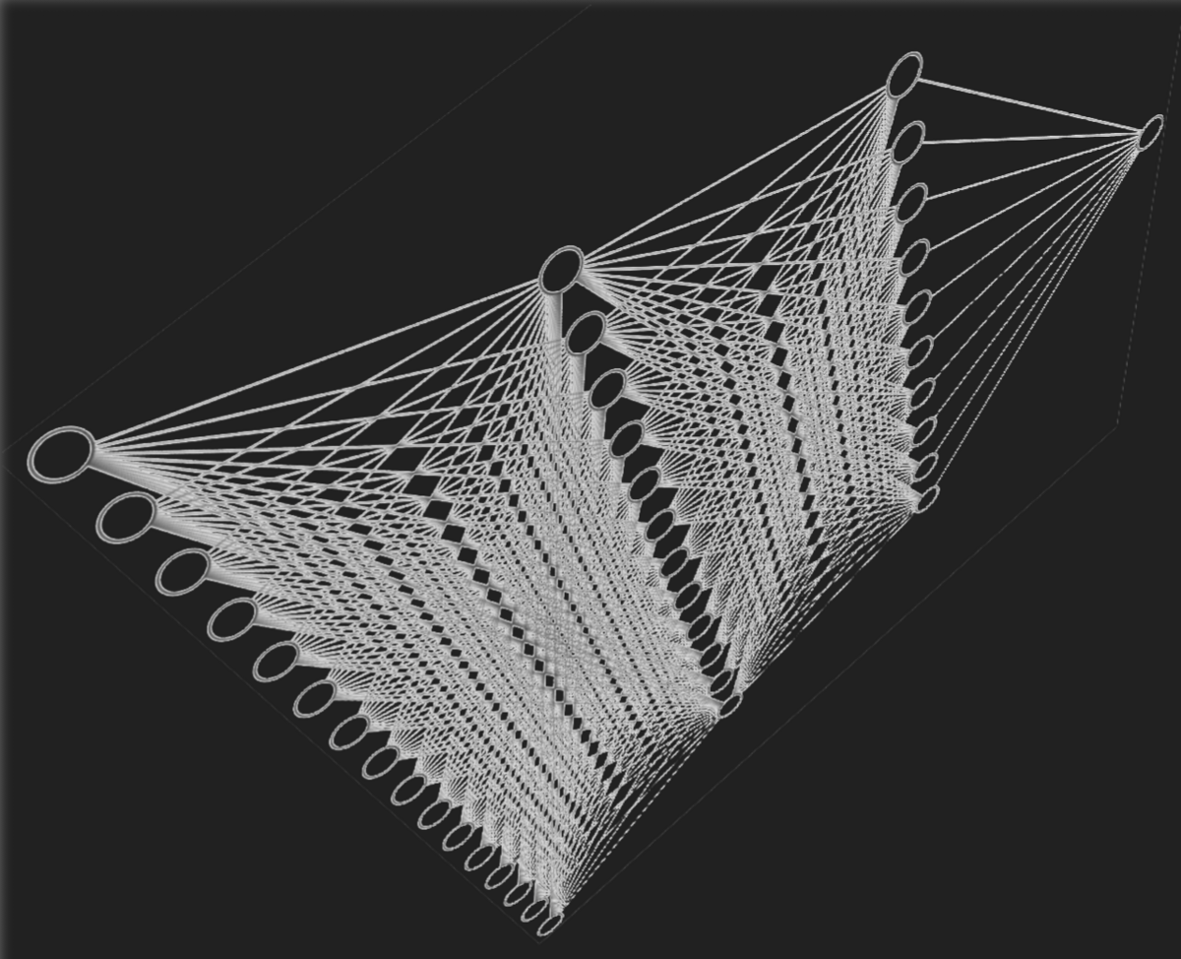
Context
Objective: Understanding the role of news media in influencing public attitudes toward artificial intelligence.
Importance: Fostering informed public discourse on AI advancements through understanding media influence.

Slide 5
Methodology - Analyzing Media Narratives
02

Slide 6

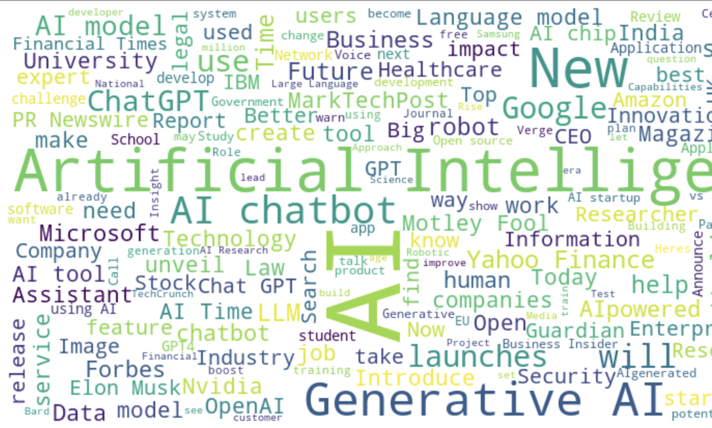
Extracting Insights from AI News Headlines
Data Source: Utilizing a comprehensive dataset of news headlines related to AI to understand prevalent narratives and themes.
Analytical Tools: Employing advanced text analytics and natural language processing (NLP) techniques to extract sentiments, themes, and trends.
Data Analysis Process: Utilizing various techniques such as word cloud, sentiment analysis, emotion detection, and trend analysis to unravel the underlying narratives in AI coverage.

Slide 7

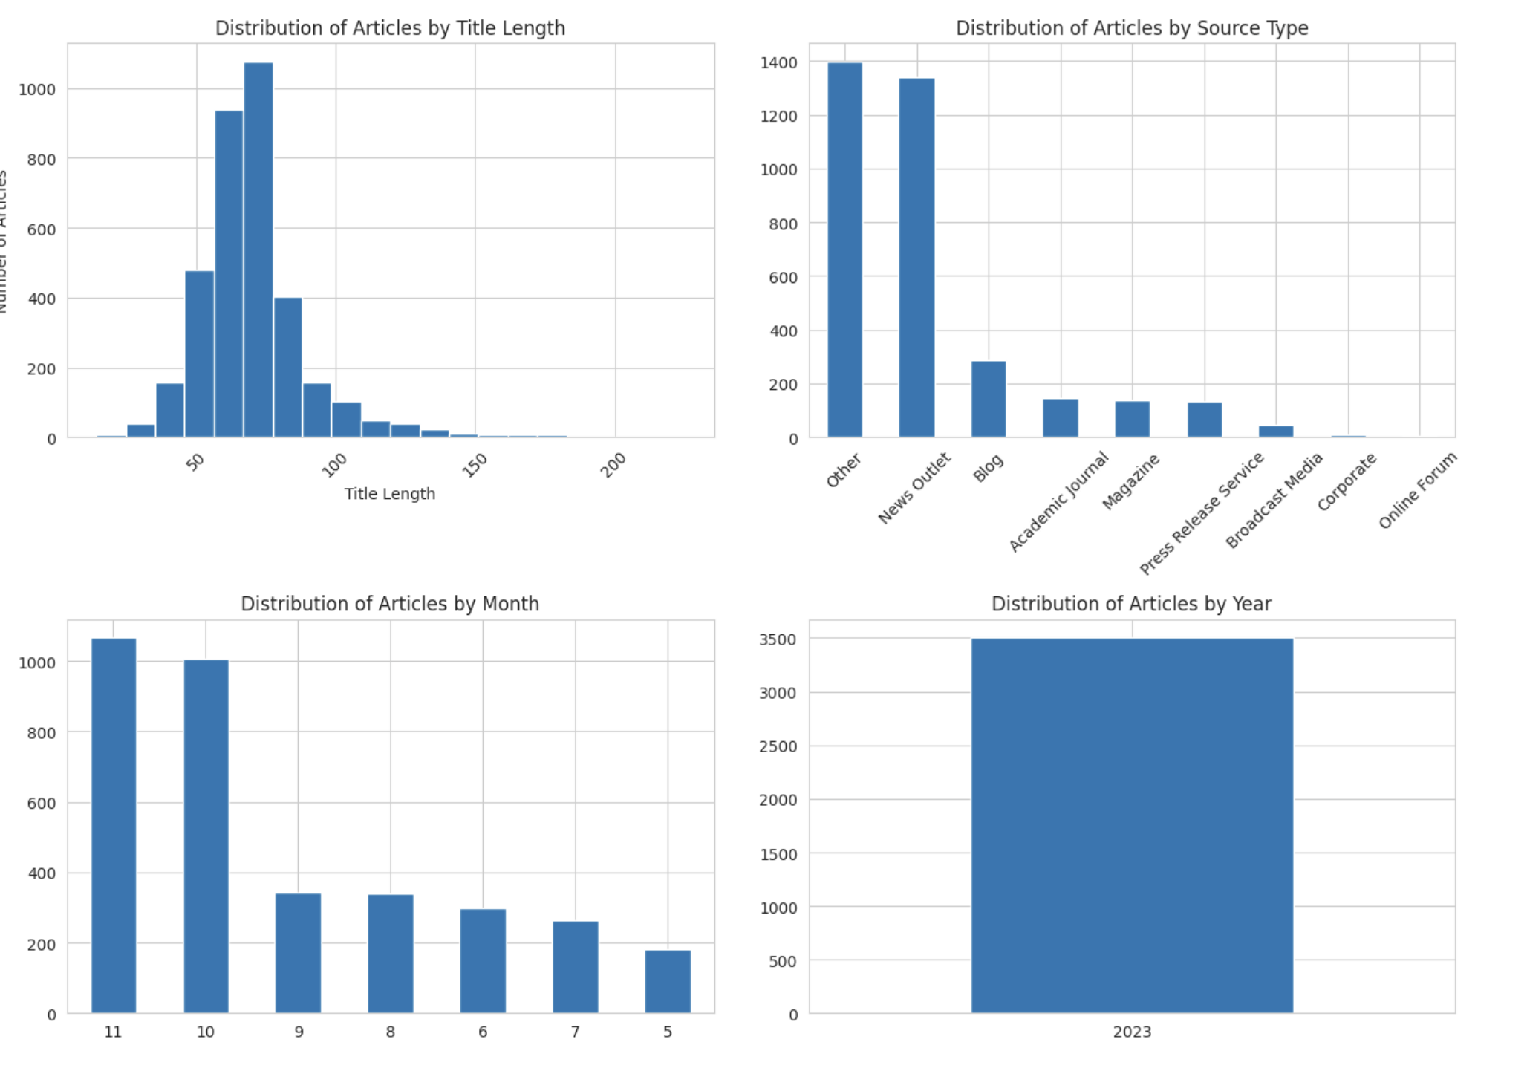
Methodology - Analyzing Media Narratives
Analysis Process | Insights
Cleaning | Ensuring data quality by removing inconsistencies and irrelevant information.
Sentiment Analysis | Categorizing articles based on positive or negative sentiment to understand the overall tone of AI coverage.
Theme Detection | Identifying and labeling the main themes in the dataset to facilitate in-depth thematic analysis [1].
Trend Analysis | Observing the evolution of media narratives around AI over time to identify significant shifts and patterns.

Slide 8
Unveiling Media Narratives
03

Slide 9
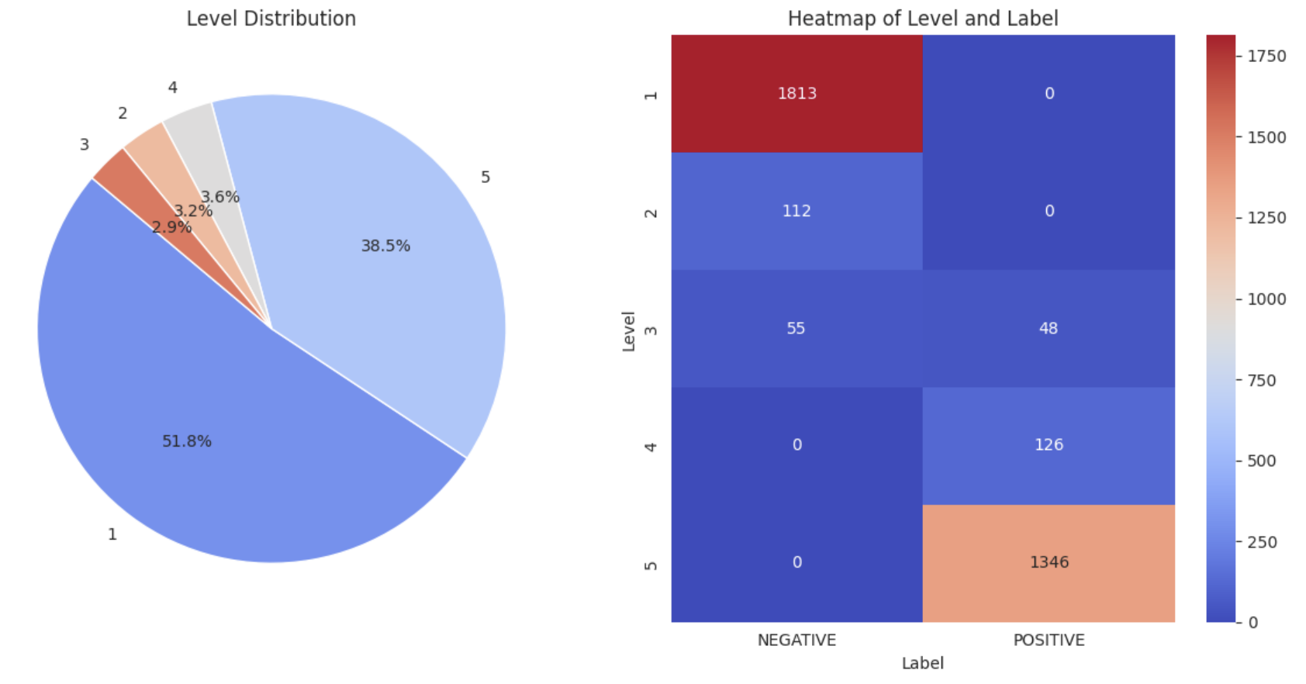
Semantic Analysis: Dividing into Sentiment and Strength
Analyzed sentiment in batches, assigning each headline a positive or negative label with a corresponding confidence score.
Introduced a five-level system to measure sentiment strength, from 'Highly Negative' to 'Highly Positive'.

Slide 10
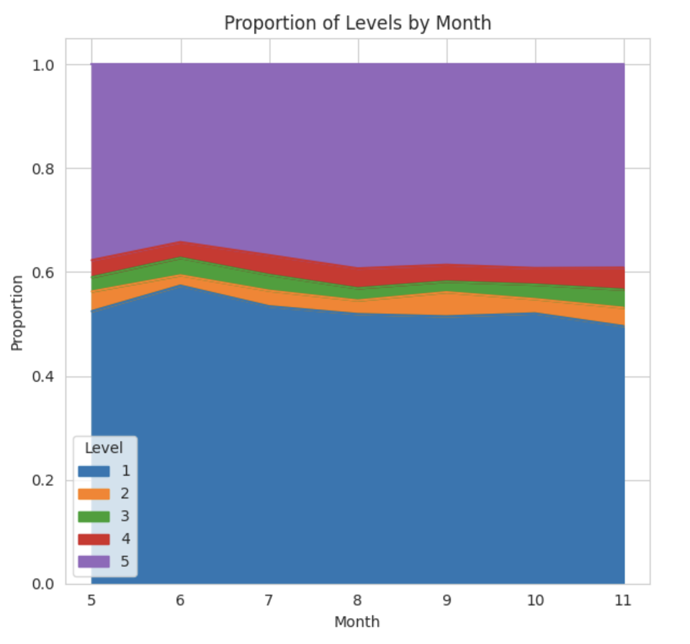
Semantic Analysis: Dividing into Sentiment and Strength
Key Insights:
Monthly sentiment trends highlight fluctuating public emotions towards AI.
The level distribution and heatmap reflect the emotional intensity and polarity of media narratives.

Slide 11
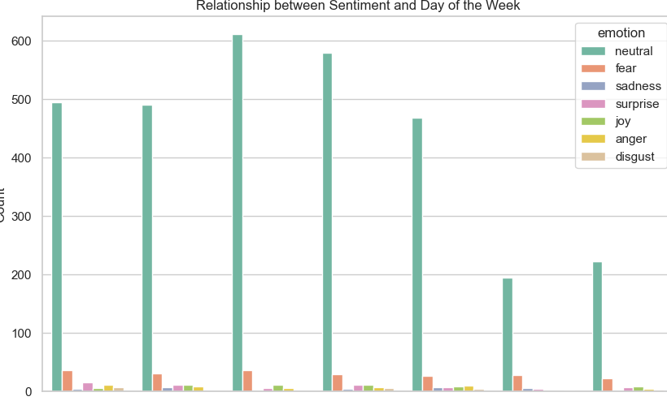
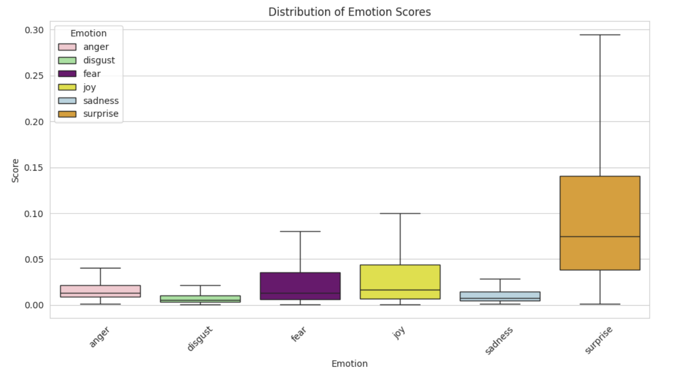
Emotion Detection
Advanced from binary labels to nuanced emotion labels,
enriching the dataset for deeper analysis.
Applied a tokenizer and a pre-trained sequence classification model to assess emotional content.
Scores across seven emotions were calculated: neutral, anger, disgust, fear, joy, sadness, and surprise.
Data shows neutral is the most prevalent emotion, with significant instances of fear and joy.
The "surprise" score has the most varied distribution, while "anger", "disgust", "sadness" has narrow distributions

Slide 12
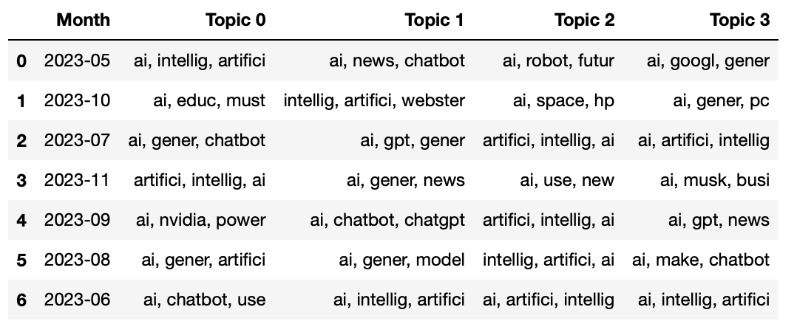
Identifying Dominant Themes
Executed Latent Dirichlet Allocation (LDA) to identify prevalent themes in AI headlines across months.
Processed data to extract topics with the top three words defining each.
Analysis suggests a diverse range of AI discussions, from technological developments of AI to its industry applications.

Slide 13
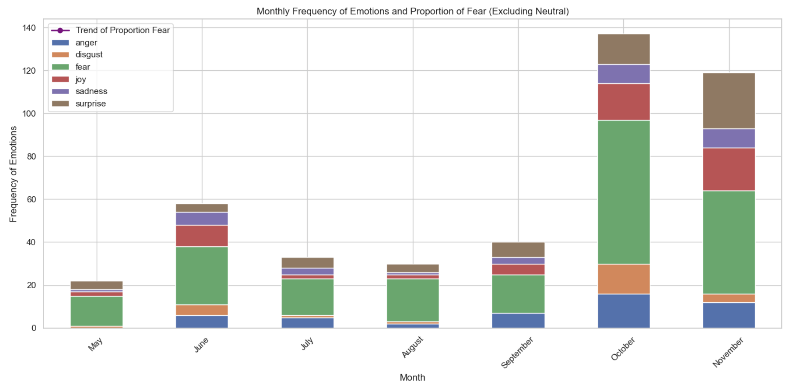
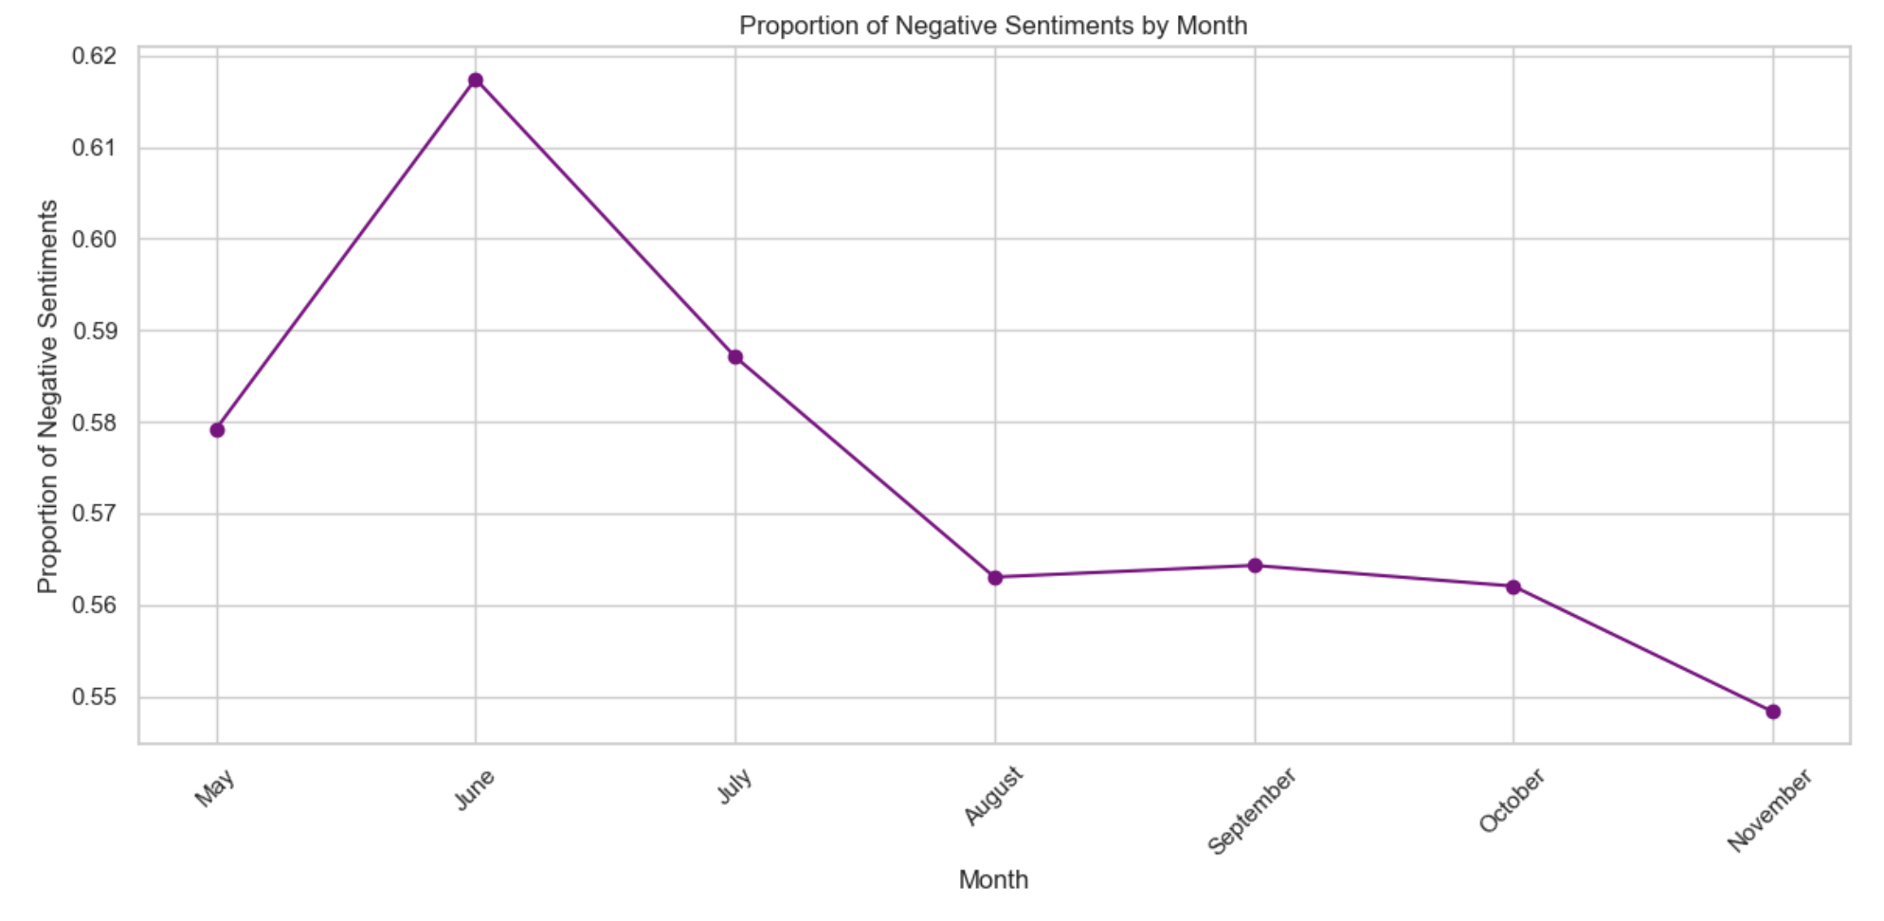
Trend Analysis
Bar Chart : Highlights the most frequent emotions associated with AI each month. A consistently high presence of 'fear' alongside 'anger' and 'disgust' suggests a negative slant in AI reporting.
Line Graph: Tracks the proportion of negative sentiments over time. A peak in this graph indicates a period where negative sentiments are particularly pronounced, possibly correlating with specific events or AI-related news.
Analysis Point: If 'fear' is frequently one of the most prominent emotions month over month, and the proportion of negative sentiments spikes or trends upwards, this could be evidence of media perpetuating fear of AI.

Slide 14
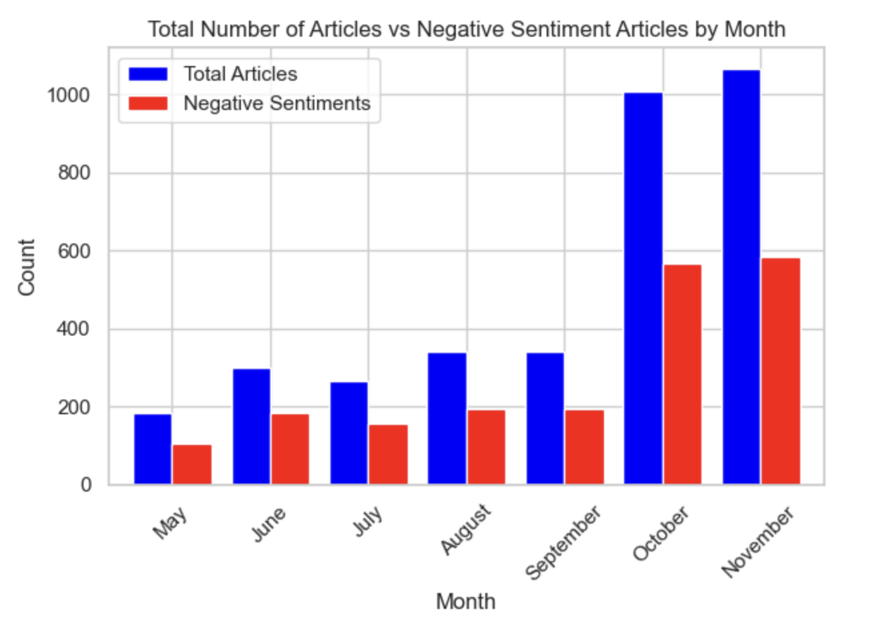
Trend Analysis
Line Graph: Illustrates a decreasing trend in the proportion of negative sentiments over the months. Despite this decline, the consistent positioning above the 50% threshold suggests that negative emotions in AI-related articles remain prominent.
Stacked Bar Chart: This chart provides a detailed breakdown of emotions per month, where 'fear' is consistently present. Even as its proportion decreases, 'fear' remains a noticeable component of the emotional makeup in AI coverage, so the portion of fear in negative emotion increases.

Slide 15
Trend Analysis
While the trend of negative sentiments in AI media coverage shows a decline, the persistent above-average volume of articles with negative tones and the enduring presence of 'fear' as a key emotion indicate that negative perceptions are still a significant part of the narrative. This could suggest that, although diminishing, the media's portrayal of AI still harbors a considerable amount of apprehension and caution.

Slide 16
Classification Models
04

Slide 17
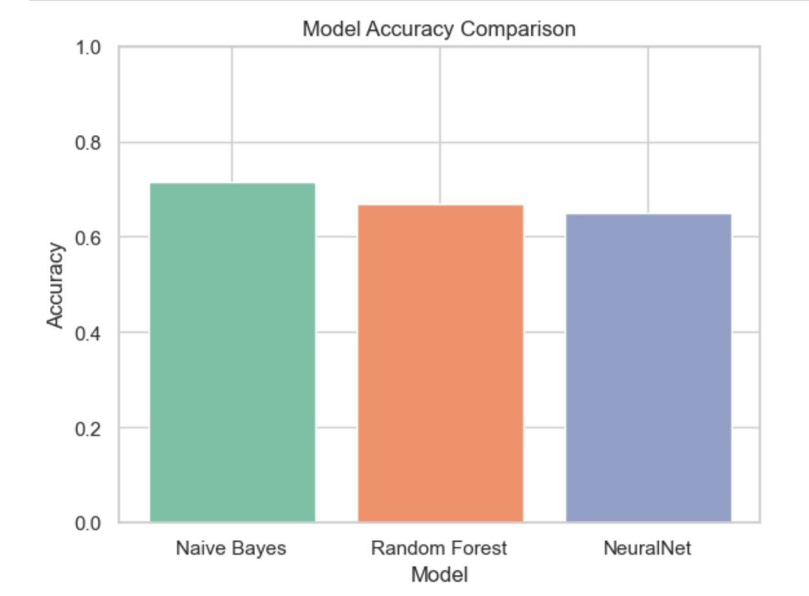
Classification Model Performance
Naive Bayes' top performance may be attributed to its effectiveness with textual data and its suitability for binary classification tasks.
The Random Forest model's results, while not as high as Naive Bayes, still reflect a considerable understanding of the dataset's features.
The Neural Network's lower performance could suggest overfitting
A model's complexity does not always guarantee superior performance; simpler models like Naive Bayes can be quite powerful

Slide 18
Conclusion
05

Slide 19


Key Findings
From our sentiment analysis, the headline sentiment is generally polarized. The 'highly positive' and 'highly negative' sentiment constitute a majority, while moderate-level sentiments have small proportions
If 'fear' is frequently one of the most prominent emotions month over month, and the proportion of negative sentiments spikes or trends upwards, this could be evidence of media perpetuating fear of AI.

Slide 20
For emotion detection, 'neutral' is the most prevalent emotion, with significant instances of fear and joy.
Emotion score of 'surprise' distributes most widely, while negative emotions such as 'anger', 'disgust', and 'sadness' have narrow range, meaning that the extend of surprise emotion varied in a greater degree

Slide 21
Reference
[1] Hartmann, J. (2022). Emotion English DistilRoBERTa-base. Hugging Face. https://huggingface.co/j-hartmann/emotion-english-distilroberta-base/
[2] Samuel, S., Jim, & et al. (2020). Covid-19 public sentiment insights and machine learning for tweets classification. Information, 11(6), 314.
[3] Sharma, M. (2020). Sentiment Analysis (introduction to naive Bayes algorithm). Retrieved from https://towardsdatascience.com/sentiment-analysis-introduction-to-naive-bayes-algorithm-96831d77ac91
[4]OpenAI. (2023). Assistance with brainstorming and structure provided by ChatGPT [Software].
https://openai.com/chatgpt

Slide 22
THE END
THANKS

